Slide 1
the Role of the Media and Entertainment Industry in Reducing Stress
How Film, Television, Radio, and Print Help Us Relax

Slide 2
Introduction
In our fast-paced, demanding world, stress has become an all-too-familiar companion. We all need ways to unwind and find moments of relaxation amidst the chaos of daily life. One of the most effective ways to achieve this is through entertainment.
The media and entertainment industry plays a crucial role in providing that much-needed escape. This industry is vast and multifaceted, encompassing various forms of entertainment that cater to diverse tastes and preferences. From the mesmerizing stories on the big screen to the engaging series on our televisions, the soothing sounds of radio, and the captivating narratives in books and magazines, entertainment is an integral part of our lives.
Today, we will explore how the different segments of the media and entertainment industry—film, television, radio, and print—contribute to reducing stress and enriching our lives. We will delve into the roles of major media companies, the economic impact of this industry, and the emerging trends shaping its future. Let's embark on this journey to understand the significance of entertainment in helping us navigate the challenges of everyday life.

Slide 3
Data Overview and Structure:
Entertainer - Basic Info: This file contains the name, gender, and birth year of entertainers.
Entertainer - Breakthrough Info: (To be reviewed) Expected to contain details on the breakthrough events or milestones in the entertainers' careers.
Entertainer - Last work Info: (To be reviewed) Expected to contain information about the latest works of these entertainers.
Analysis Goals:
Demographics: Analyze the distribution of entertainers by gender and birth year.
Career Milestones: Identify key breakthrough events for different entertainers and any common trends.
Recent Works: Assess the latest contributions of entertainers to the industry and their impact.
Data Analysis Steps:
Data Cleaning and Preparation: Ensure the data from all files is consistent and properly formatted.
Descriptive Statistics: Provide summary statistics for age distribution, gender representation, etc.
Trend Analysis: Examine the breakthrough events and recent works to identify trends in the entertainment industry.
Visualization: Use charts and graphs to illustrate key findings.

Slide 4
Main KPIs
Demographics Analysis
Career Milestones
Recent Works

Slide 5
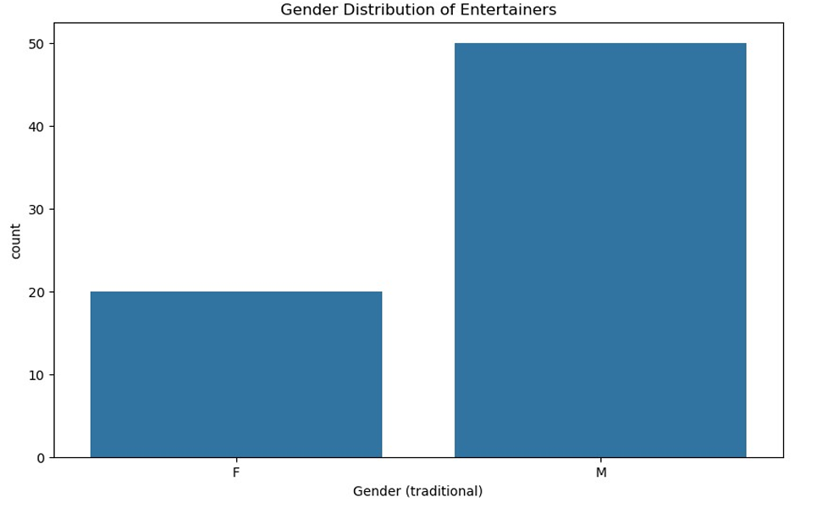
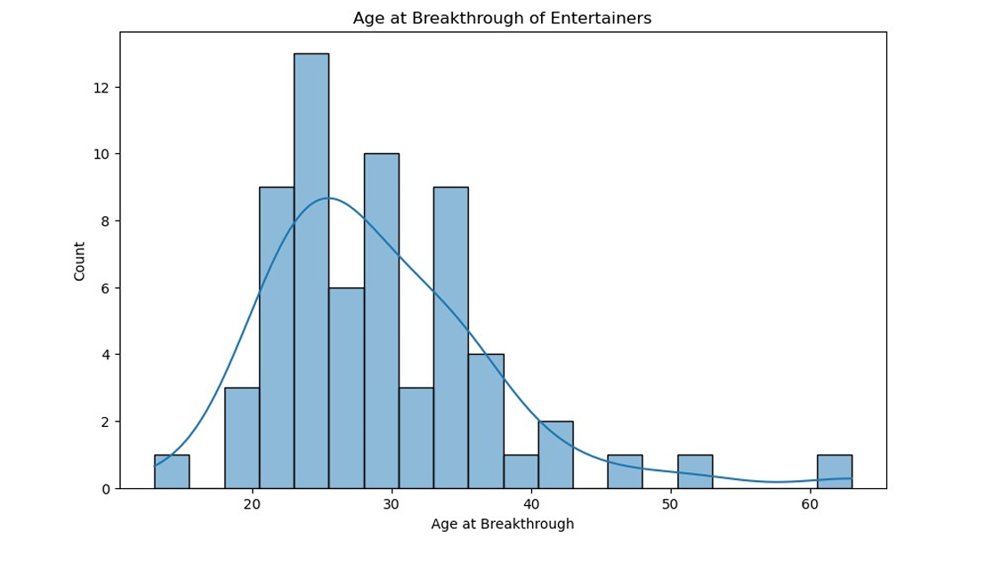
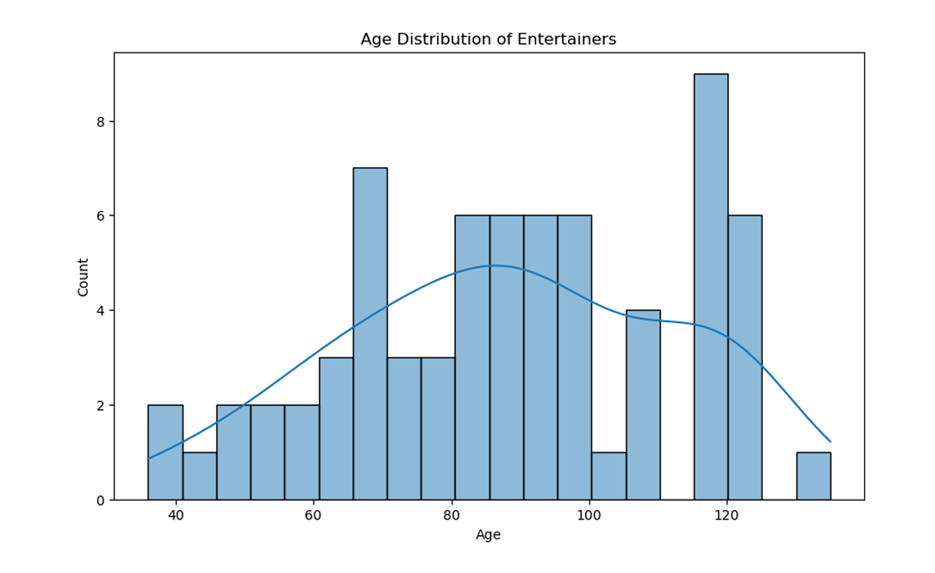
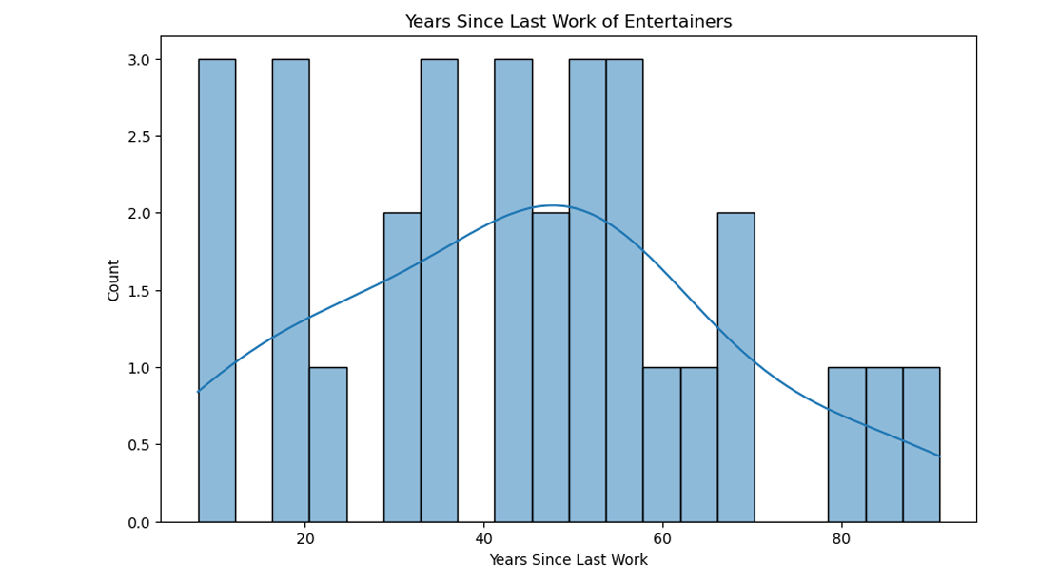
My Design

Slide 6
Thank you

